Slide 1

CAMPUS LOST AND FOUND PORTAL
Mentored By - Suramya Biswas
TEAM MEMBERS:
Dhaswan K
Sivanesan T
Kapilan P. C
Sona N
Mohanasankari D

Slide 2
Agenda
01
02
03
Project Overview
Technology Stack
Core Features
Problem, solution, and outcomes
Tools and frameworks used
Key modules and functionality
04
05
Implementation
Conclusion
Development journey
Results and learnings

Slide 3

The Challenge
The Problem
Every College, students lose countless items across campus phones, laptops, wallets, textbooks, and keys. Traditional lost and found systems rely on manual processes: checking bulletin boards, calling security offices, or hoping someone posts on social media.
This traditional approach leads to frustration, wasted time, and items that never find their way home.

Slide 4


Our Solution
We built a centralized web portal that streamlines the entire lost and found process. Students can quickly post lost or found items with detailed descriptions, photos, and location data. The system then uses intelligent matching algorithms to automatically suggest potential matches between lost and found listings.
Centralized Listings
Smart Matching
All campus lost and found items in one searchable database
AI-powered suggestions connect items with owners automatically
Secure Platform
Admin moderation and analytics ensure safety and efficiency

Slide 5








Technology Stack
Built with industry-standard tools and modern frameworks for scalability and performance
React Js
Spring Boot 3.3.0
Java 17
VS Code
Spring Data JPA
Spring Security
MySQL 8
Eclipse IDE

Slide 6
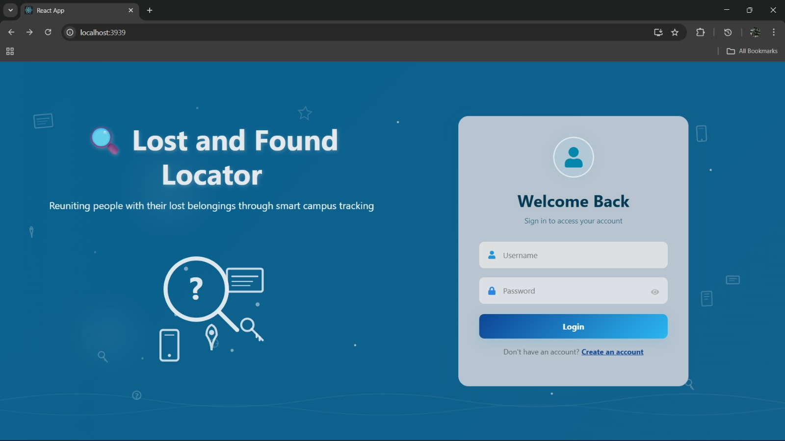
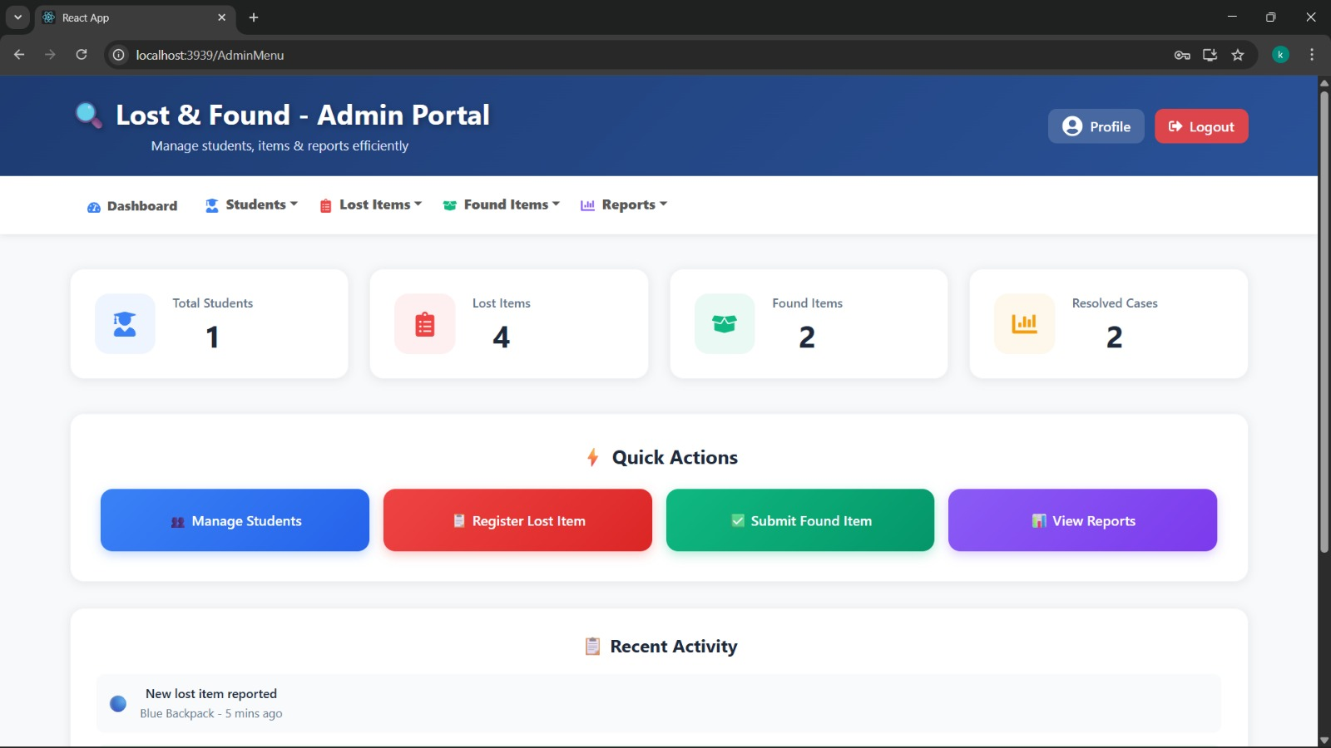
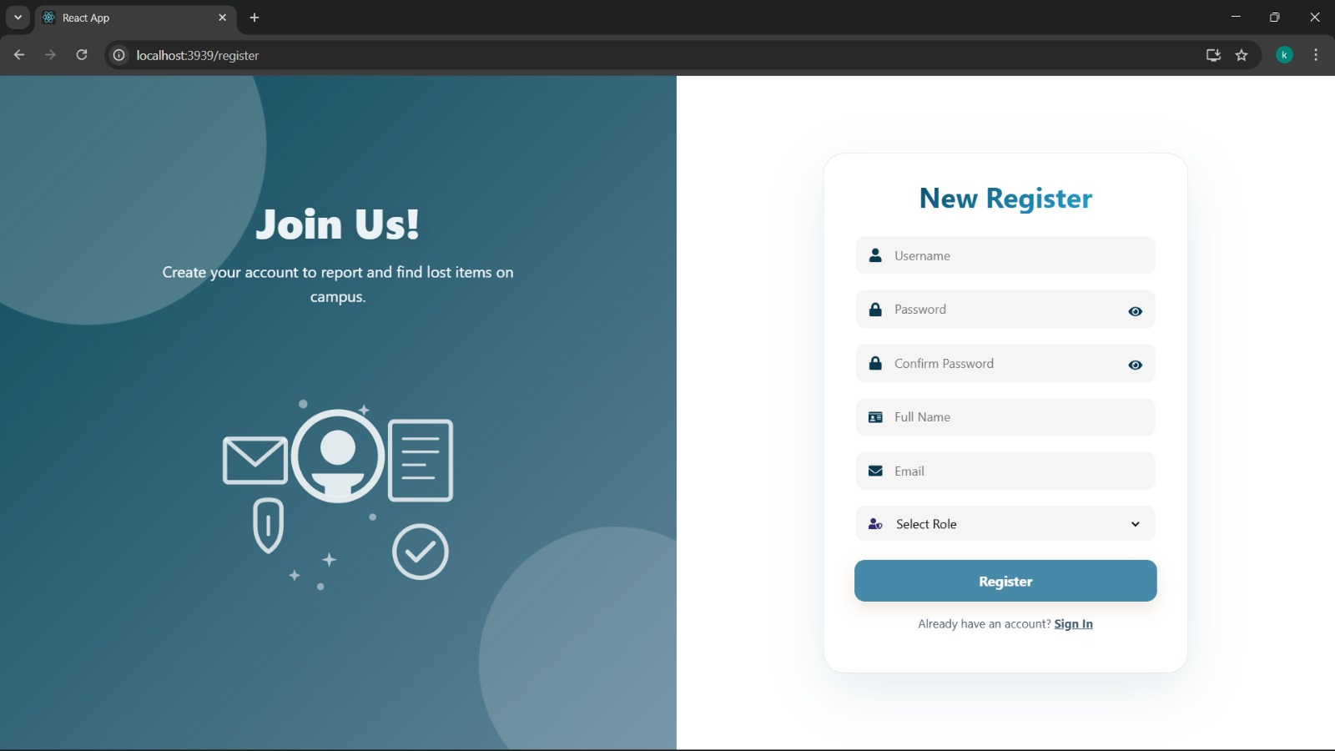
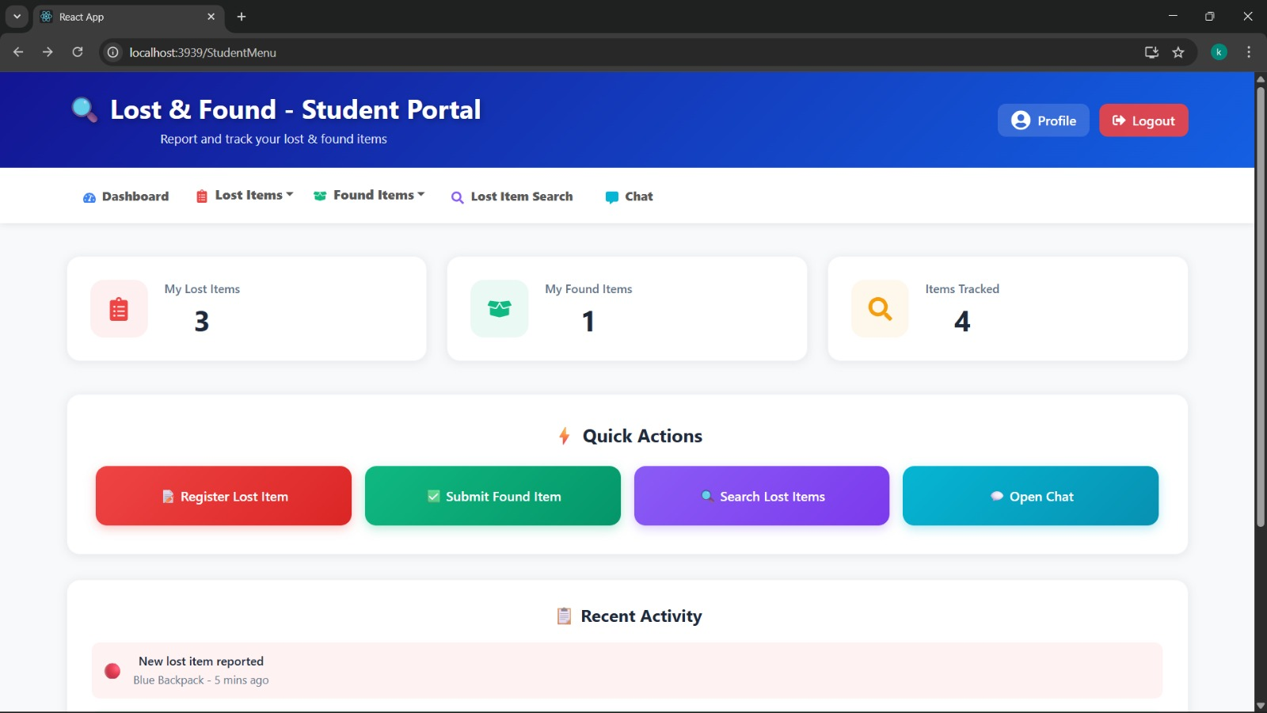
Website View

Slide 7
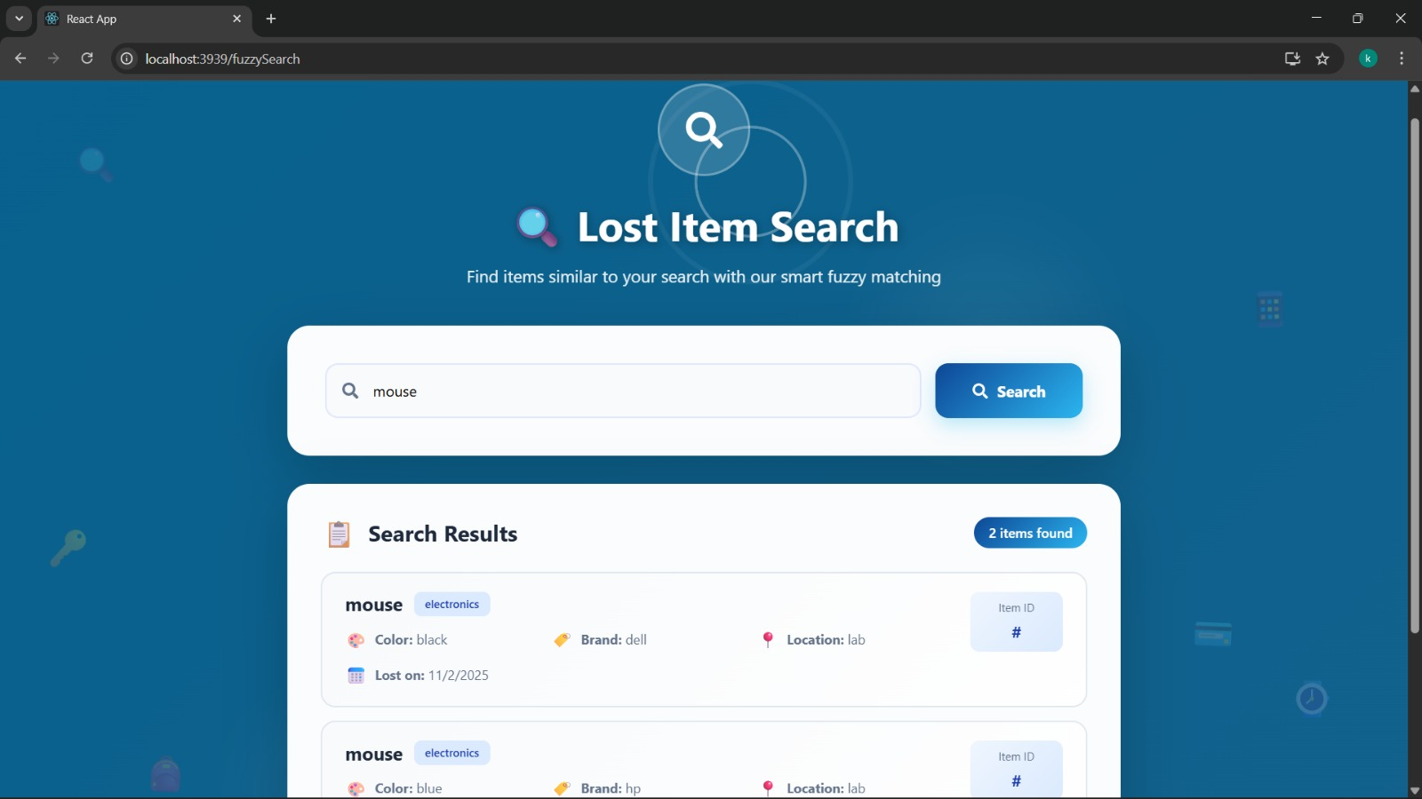
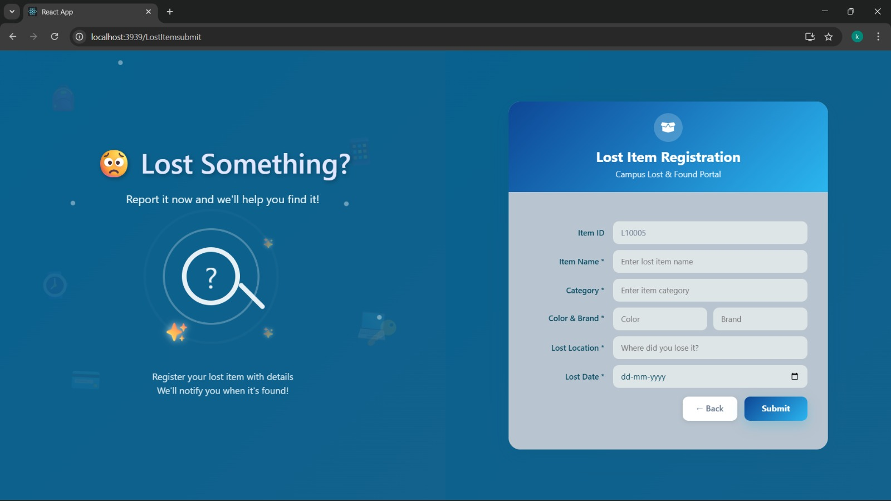
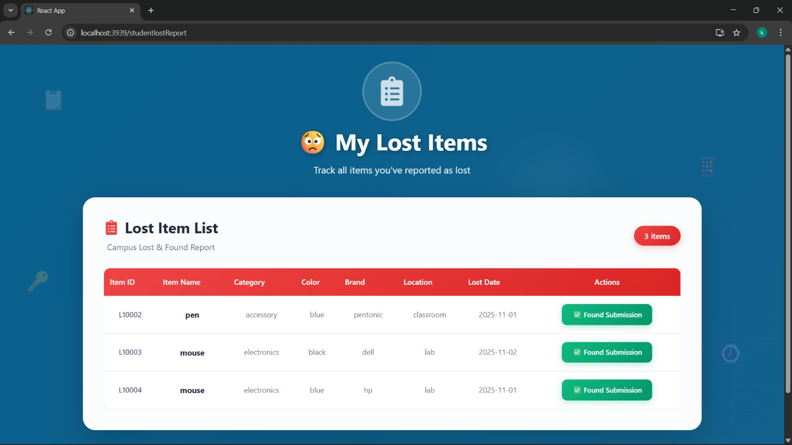
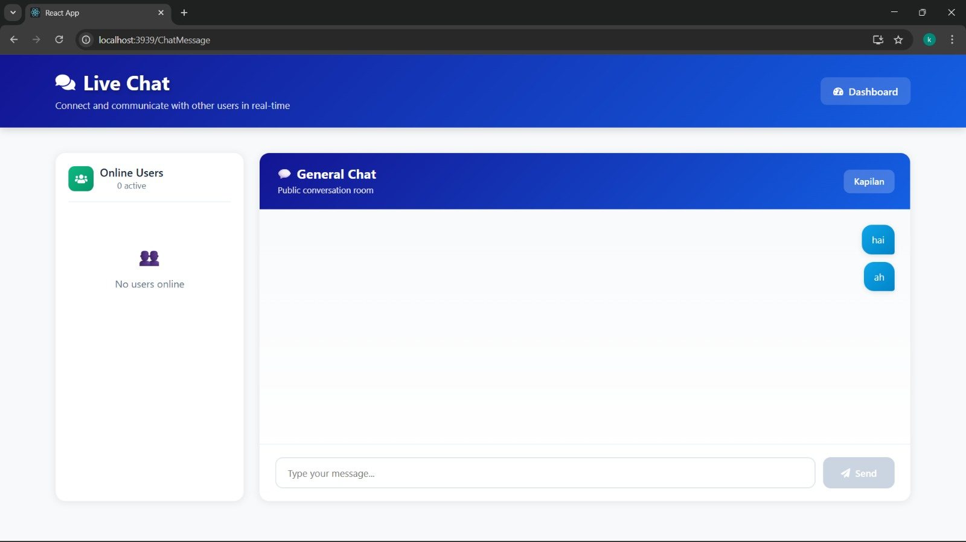

Slide 8





Core Features & Modules
Authentication & Roles
Separate access levels for students and administrators with secure login and session management
Post Lost/Found Items
Structured forms with category tags, location details, and timestamp tracking
Auto-Matching System
Fuzzy keyword search and location-based algorithms generate intelligent match suggestions instantly
Secure Chat
In-app messaging enables direct communication between users without exposing personal contact
information
Admin Dashboard
Comprehensive tools for managing posts, moderating flagged content, and generating analytical reports

Slide 9
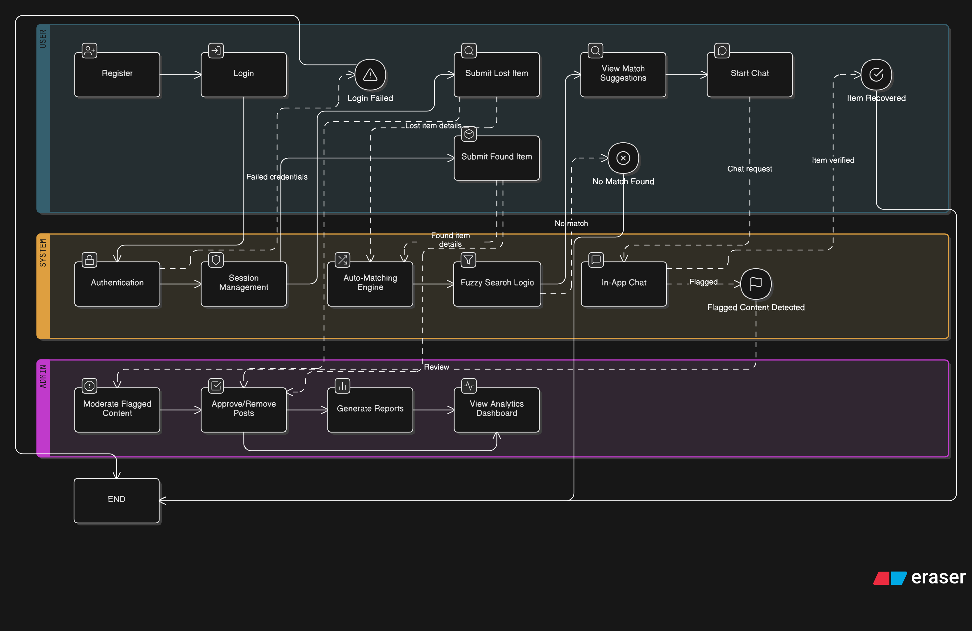
System Architecture

Slide 10
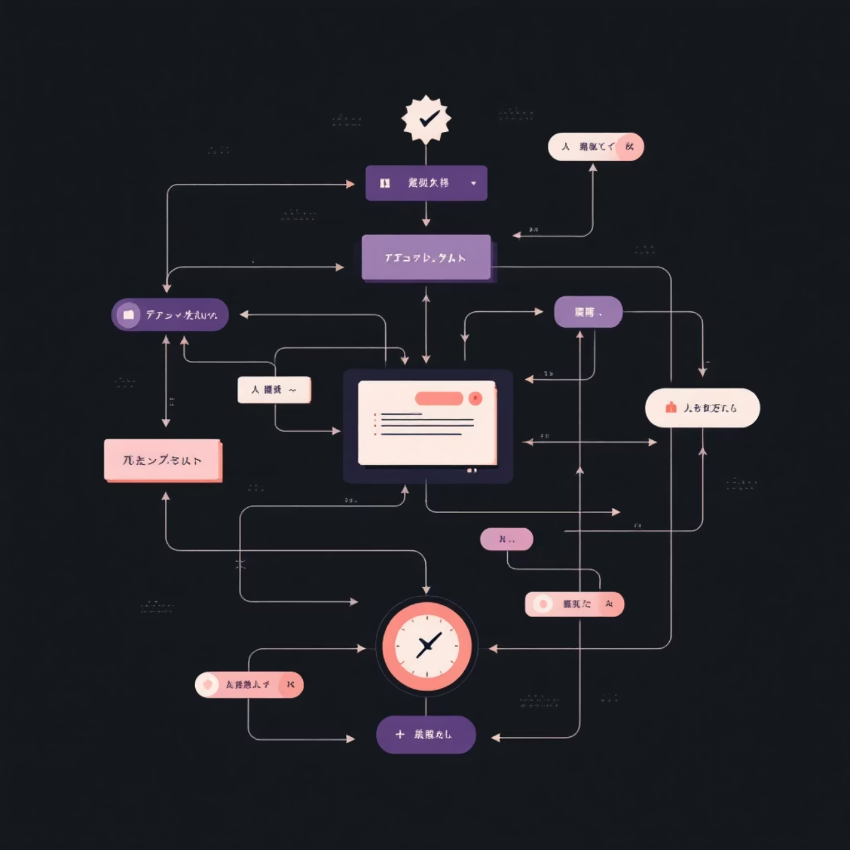
How Auto-Matching Works
User Posts Item
1
Student submits detailed description with keywords, category, and location
2
Algorithm Scans Database
System analyzes all existing listings using fuzzy matching and location proximity
Matches Generated
3
Top potential matches ranked by relevance score and displayed to user
4
User Connects
Student initiates secure chat with potential match to verify ownership

Slide 11

Future Enchancement
Mobile Application Development
AI-Based Image Recognition
Integration with Campus ID and CCTV Systems
Voice Assistant and Multilingual Support

Slide 12
Key Takeaways
Campus Impact
Technical Growth
Problem Solving
Transformed how students report and recover lost items, creating a more connected campus community
Gained real-world experience building full-stack applications with React, Spring Boot, MySQL, and RESTful APIs
Applied design thinking to solve a genuine campus need with innovative technology solutions
Thank You!
Questions and feedback welcome

